Slide 1
10 | Introducing scripting and toolmaking
Jeffrey Snover | Distinguished Engineer & Lead Architect
Jason Helmick | Senior Technologist, Concentrated Technology

Slide 2


Course Topics
Getting Started with PowerShell
01 | Don’t fear the shell | 06 | The pipeline : Deeper
02 | The Help system | 07 | The Power in the Shell - Remoting
03 | The pipeline : Getting connected | 08 | Getting prepared for automation
04 | Extending the shell | 09 | Automation in scale - Remoting
05 | Objects for the Admin | 10 | Introducing scripting and toolmaking

Slide 3
Module Overview
The new ISE
Making commands repeatable
Adding parameters to your script
Documenting your script
Turning your script into a tool for others
Storing your tools in a module

Slide 4
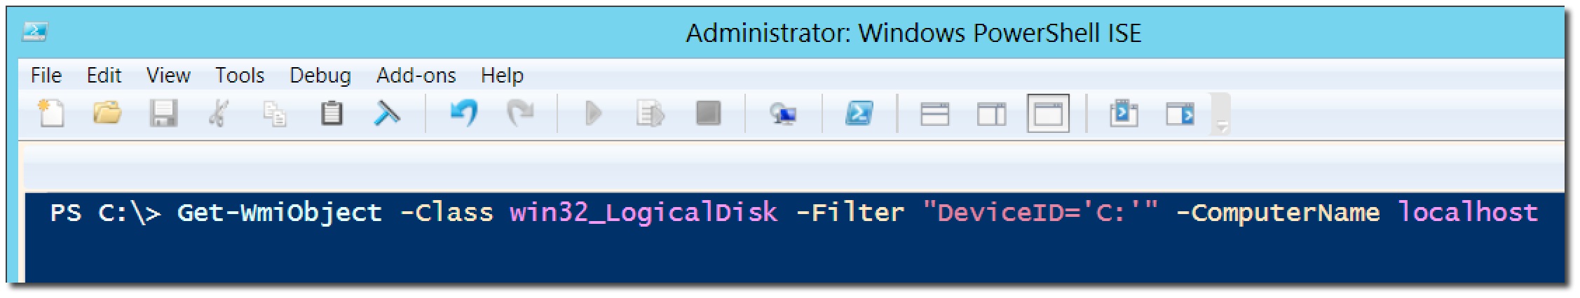
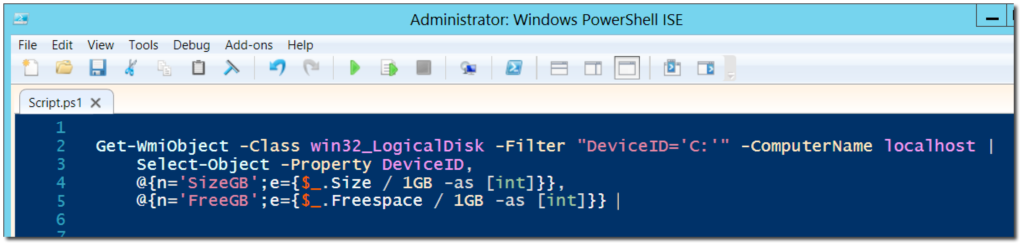
The new ISE

Slide 5
Making commands repeatable

Slide 6
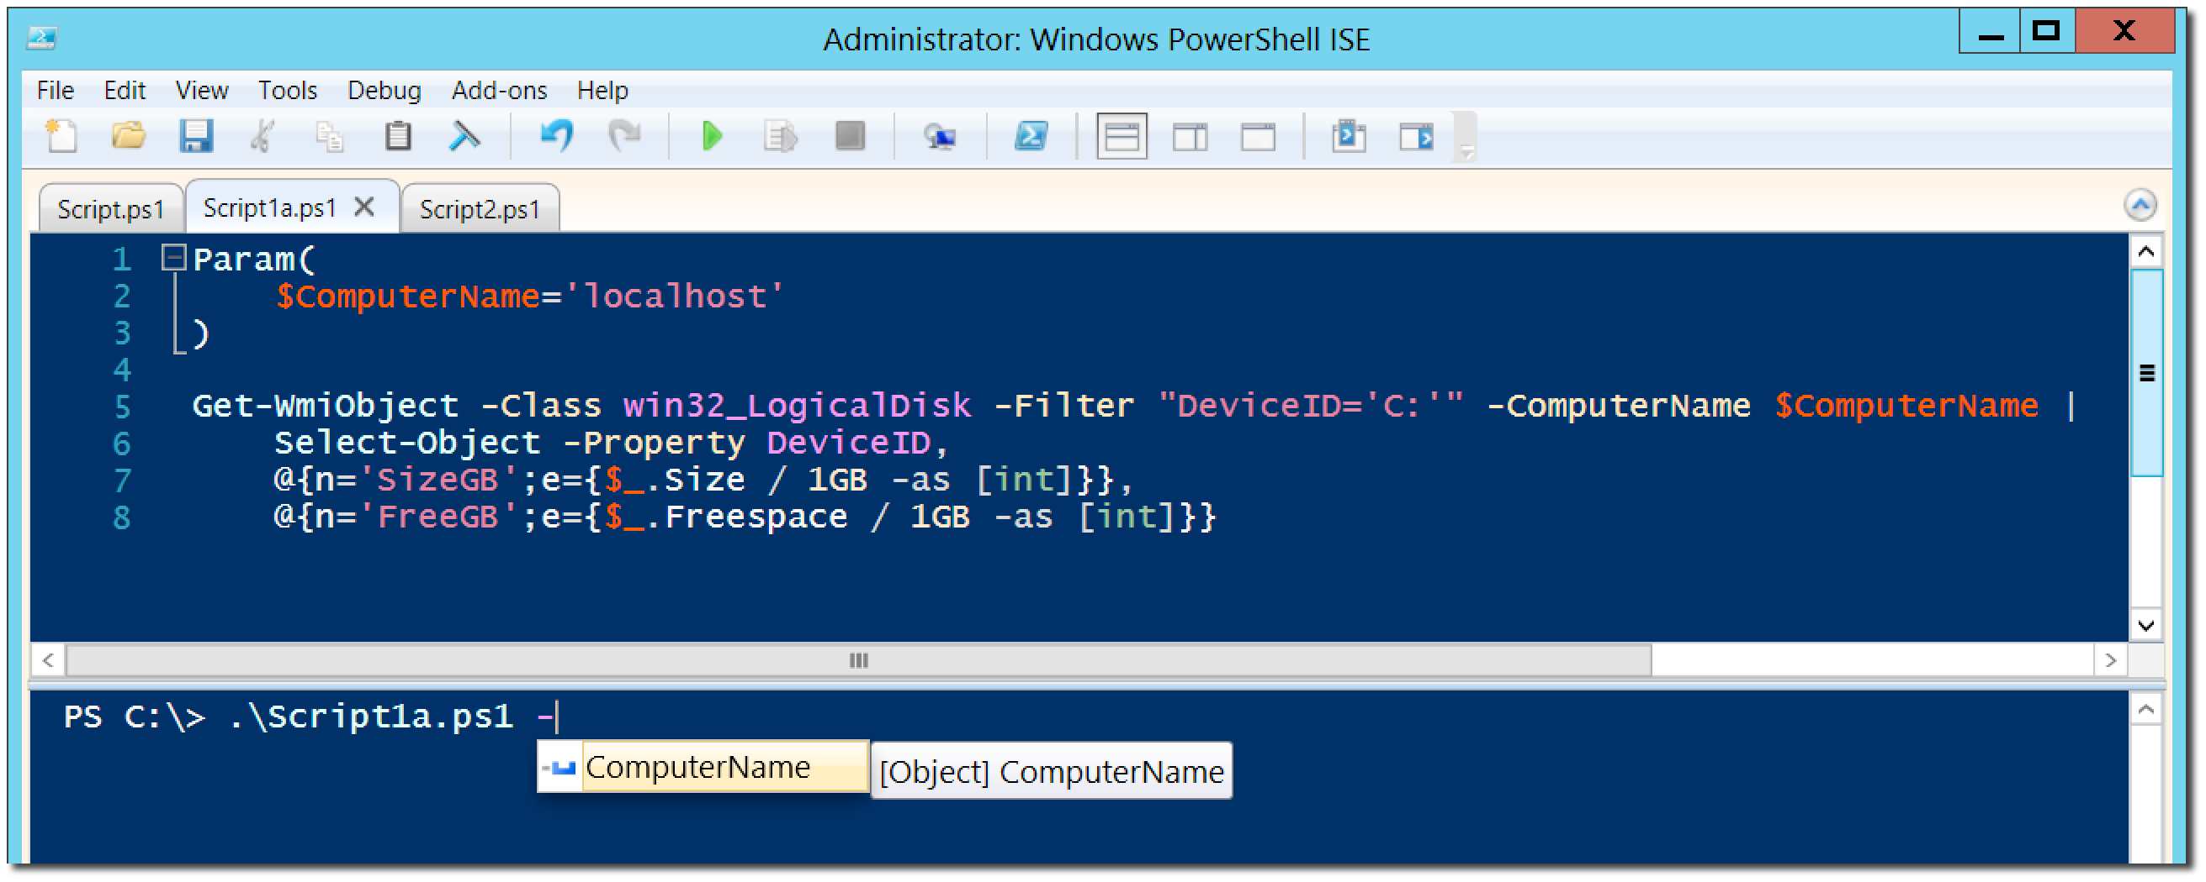
Adding parameters to your script

Slide 7
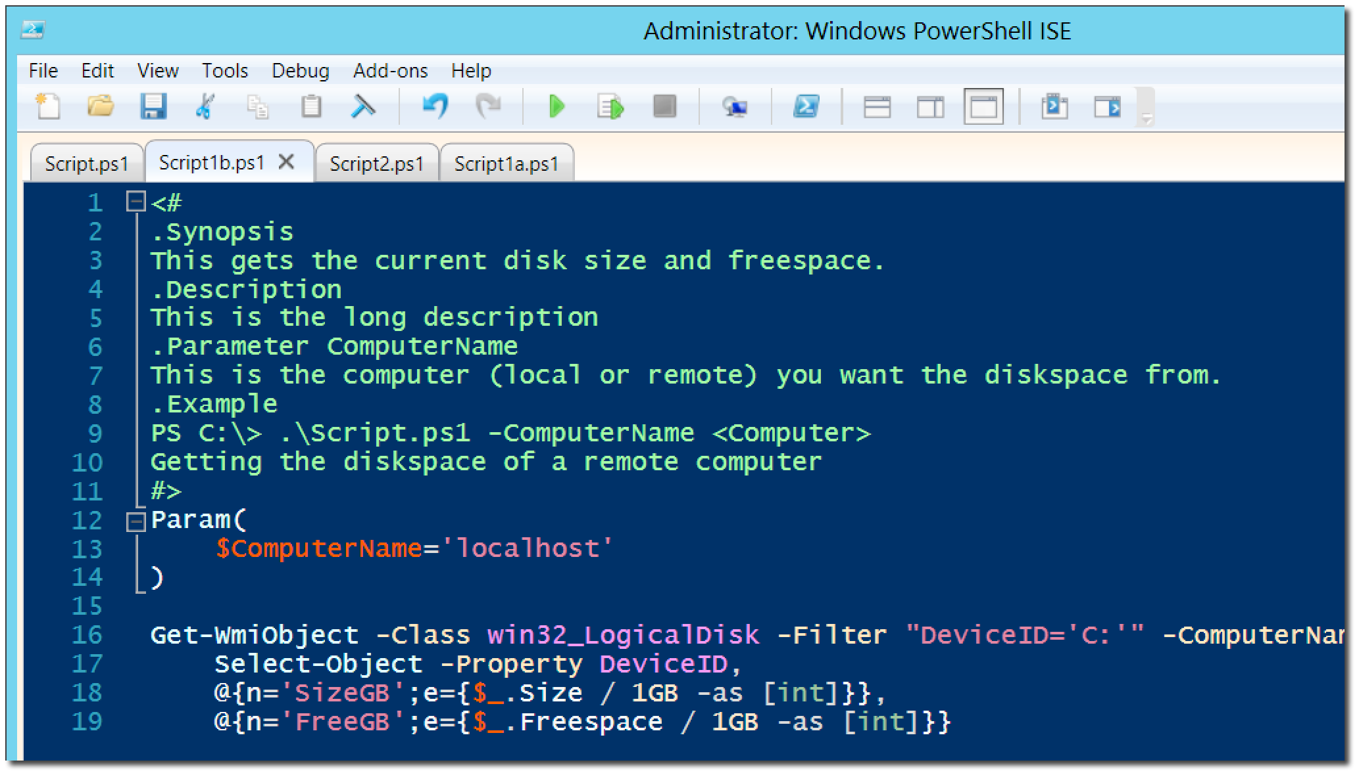
Documenting your script

Slide 8
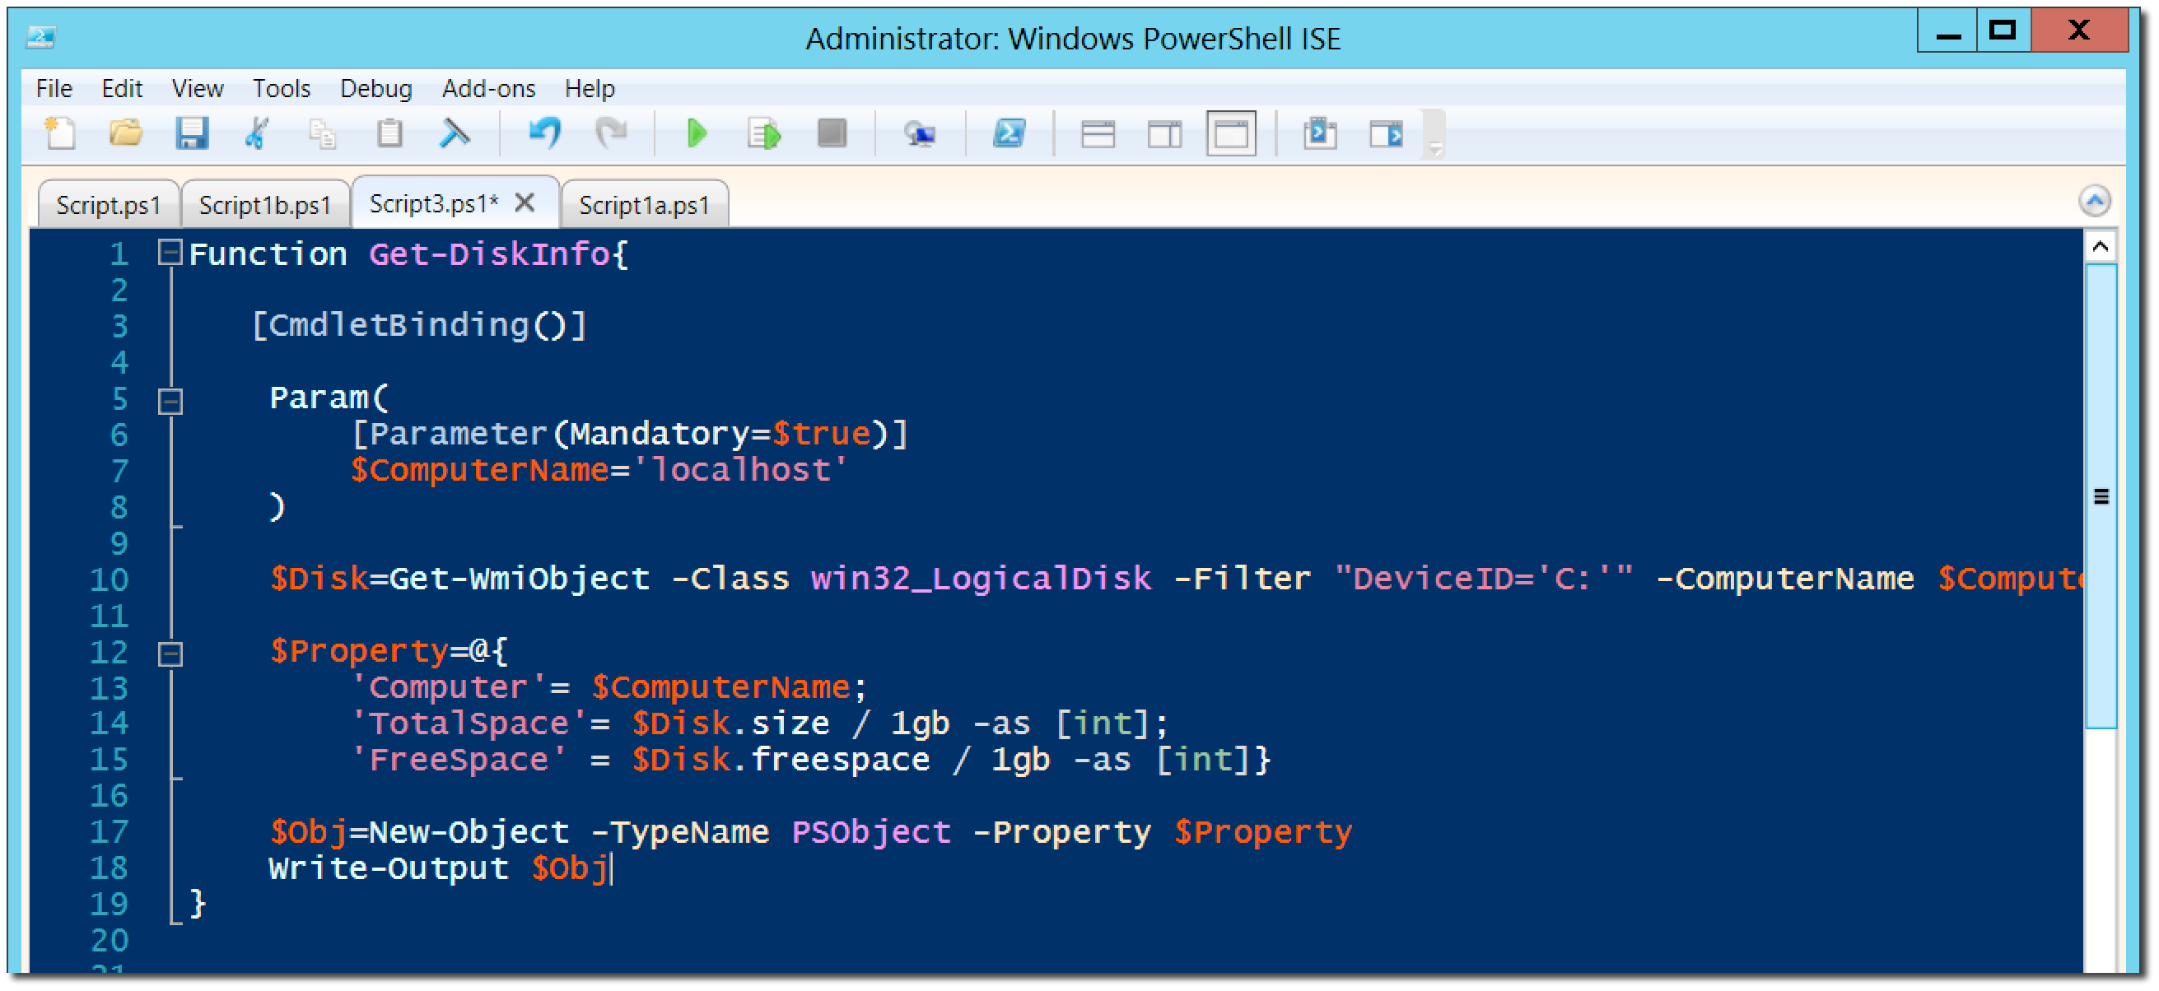
Turning your script into a tool for others

Slide 9
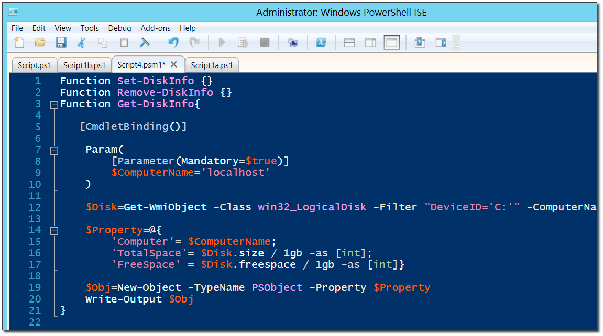
Storing your tools in a module

Slide 10
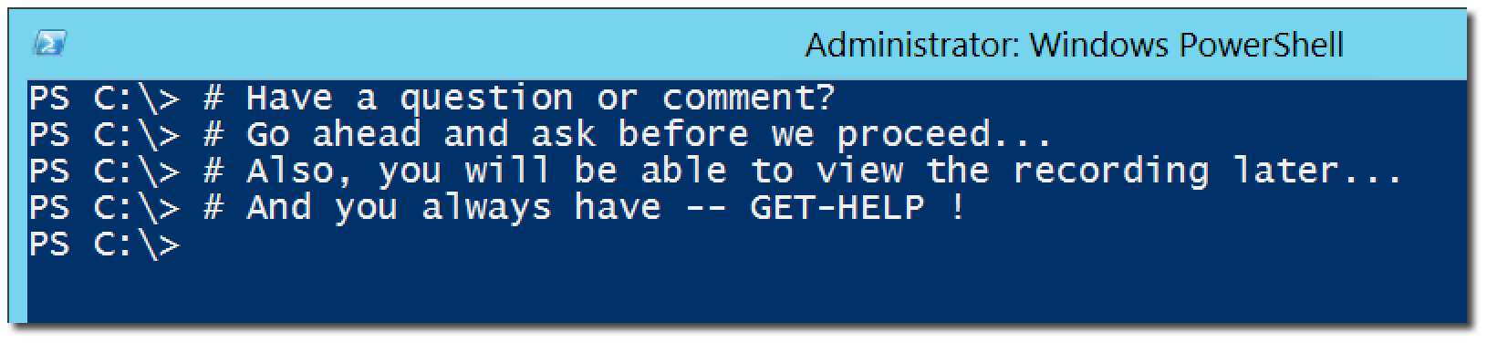
Questions or comments?

